Slide 1

  E.L.O.R.A – Employee Leave Orchestration and Resource Administration
SOA Project Review - 2
 | Under the Guidance of Mrs. R. Navyatha Assistant Professor, Department of Computer Science and Engineering, KLH CSE Bowrampet Campus
Team Members C Pravin Sai – 2420030777 B Raghu Nandan – 2420030058 J Hemanth Krishna - 2420039805

Slide 2
Problem Statement
Organizations need a structured way for employees to request leave and managers to approve or reject requests.
Organizations need a structured and reliable way for employees to submit leave requests with valid dates and reasons, while managers need an efficient process to review, approve, or reject those requests. The system requires secure authentication and role-based authorization to protect leave operations. A monolithic implementation can tightly couple identity, employee data, leave processing, and notifications, making the system difficult to maintain and scale. Therefore, the proposed system separates these capabilities into independent microservices, providing a secure, structured, and decoupled approach to leave management.
Core problem: secure, structured and decoupled leave management.

Slide 3
Objectives
Implement independent microservices for Authentication, Employee, Leave, and Notification.
Secure the system using JWT authentication and role-based access control for employees, managers, and administrators.
Implement the complete leave lifecycle including application, validation, approval/rejection, history, and event-based notifications using REST and Kafka.
Maintain database ownership per service and validate the system through integration testing, Postman, security checks, and CI workflows.

Slide 4
PROJECT DESIGN
The Leave Management System is designed as a service-oriented microservices application for the Recruitment & HR domain. The system separates the major business functions into four independent services: User/Authentication Service, Employee Service, Leave Service, and Notification Service. The User Service manages registration, login, user roles and JWT generation; the Employee Service maintains employee profiles, departments and manager relationships; the Leave Service handles leave application, validation, status, approval, rejection and leave history; and the Notification Service consumes events and manages user notifications. Spring Cloud Gateway acts as the single entry point for the client and routes requests to the appropriate service, while Eureka provides service registration and discovery. Each microservice maintains ownership of its own database, preventing direct access to another service's data. REST APIs are used for synchronous operations, while Apache Kafka is used to carry asynchronous leave events such as LEAVE_APPLIED, LEAVE_APPROVED and LEAVE_REJECTED. The complete design supports the workflow from user registration and login to leave application, manager decision, status update and notification.

Slide 5
METHODOLOGY ADOPTED
Module 1 - User Authentication
Register / Login → JWT Authentication → Role Identification → Access Granted
Module 2 - Employee Management
Employee Profile → Department Details → Manager Mapping → Employee Information
Module 3 - Leave Management
Apply Leave → Leave Validation → Store Leave Request → Send to Manager
Module 4 - Manager Approval
Manager Views Request → Approve / Reject → Update Leave Status
Module 5 - Event & Notification
Leave Status Changed → Publish Event to Apache Kafka → Notification Service Consumes Event → Generate Notification
Events:
LEAVE_APPLIED → LEAVE_APPROVED / LEAVE_REJECTED
Module 6 - Leave History
Updated Leave Status → Leave History → Employee Views Status & History
User Login → Employee Management → Apply Leave → Validation → Manager Approval/Rejection → Kafka Event → Notification → Leave History

Slide 6
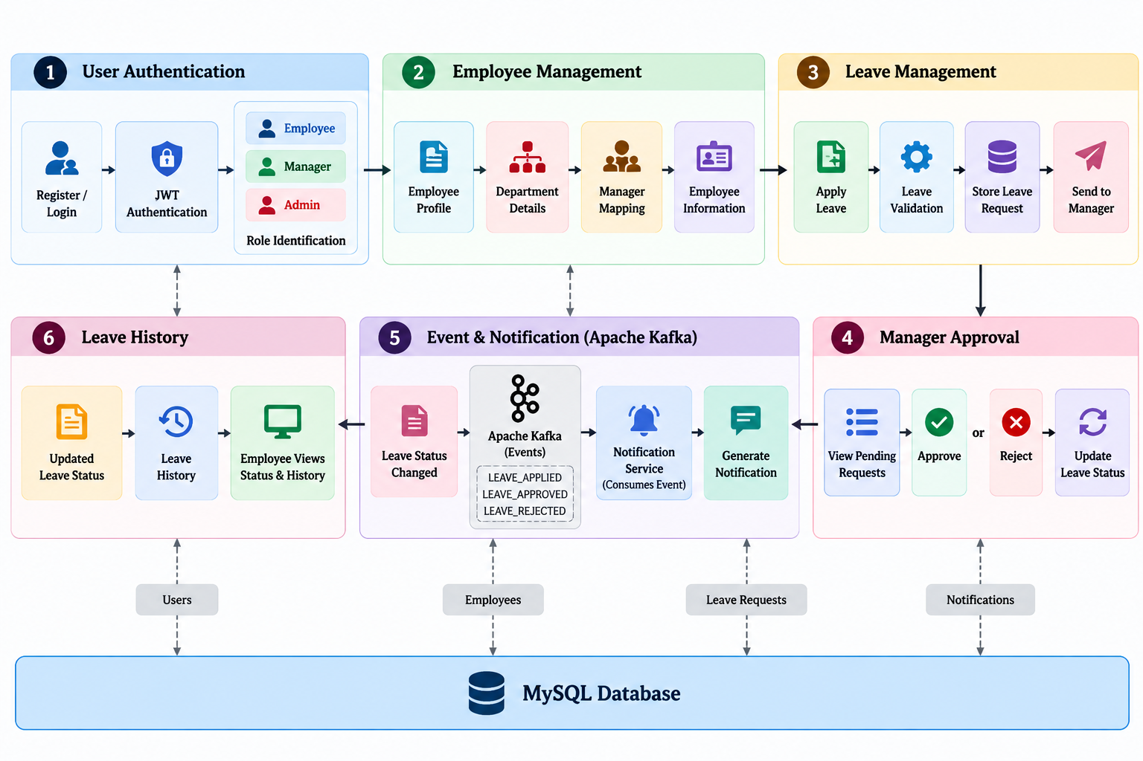
METHODOLOGY ADOPTED

Slide 7
TECHNICAL SOUNDNESS OF THE PROJECT
Frontend: React.js
Backend: Java + Spring Boot + Spring Web + Spring Data JPA
Security: JWT
Database: MySQL
Communication: REST API
Messaging: Apache Kafka
Testing: Postman + JUnit
Build: Maven

Slide 8
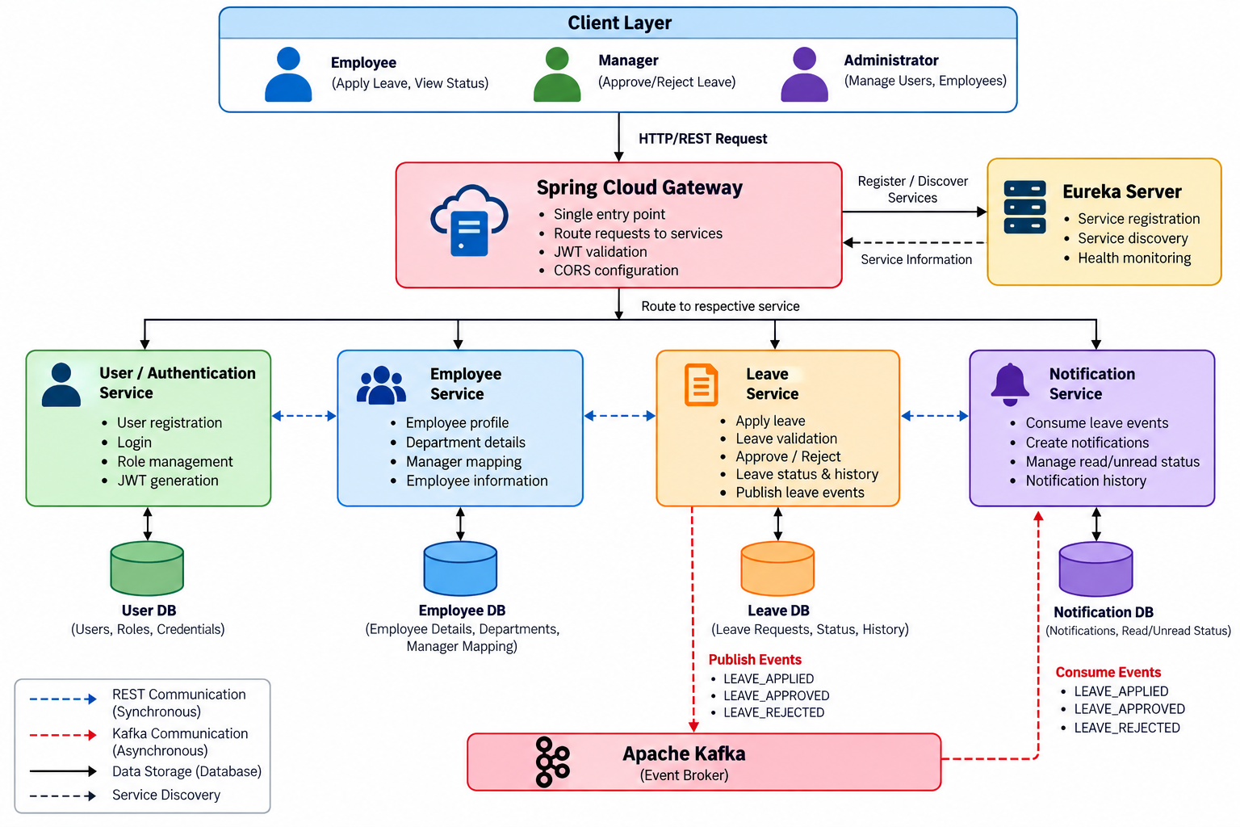
SYSTEM DESIGN

